Slide 1
CISC108
Introduction to Computer Science
[TA Name]
[TA Name]
University of Delaware
Week 2 - Functions

Slide 2
[TA Name]
[TA Name]
[TA Photo]
[TA Photo]

Slide 3
Warm-up Introductions
Be prepared to say:
Name
Year
Major
What acquired skill, besides programming, have you always wanted to learn?
Example:
“I am Ada Lovelace, I am a freshman Computer Science major, and I have always wanted to learn karate.”

Slide 4
What is Lab for?
A “Practicum” assignment to reinforce that week’s material
Sometimes, a chance to get help from the TA on open assignments

Slide 5
Reminder:
Read the Primer!!
Each week, you are responsible for at least reading the Primer BEFORE lecture or lab.

Slide 6
Review: Week 1 Basics
You should now be able to:
Write and run basic programs
Write expressions involving math and logic
Use variables to store values for later
Print data to the console
Use string operations to manipulate text data
Organize code into importable modules

Slide 7
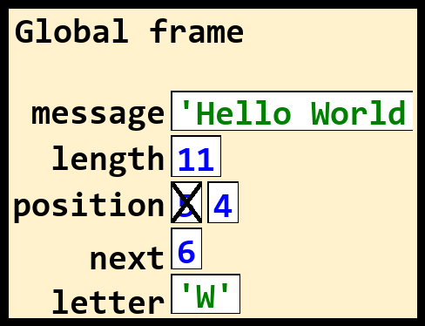
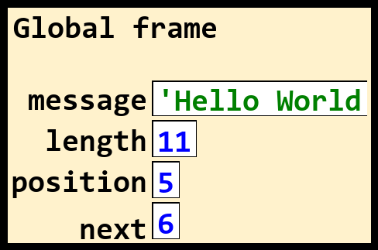
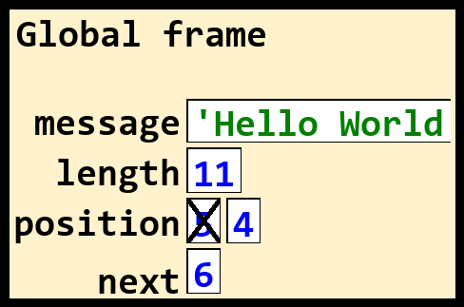
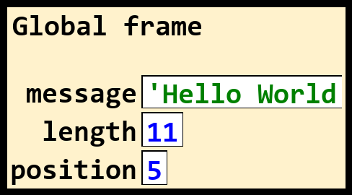
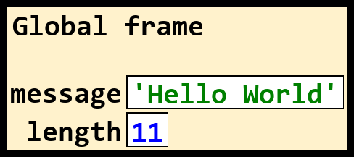
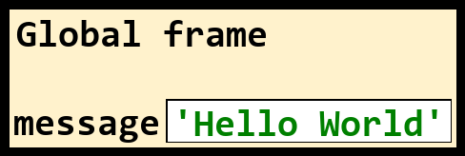
Review: a basic program
message = "Hello World"
# Some example math operations
length = 11
position = length // 2
next = position + 1
position -= 1
# Index a character
letter = message[next]
# Print the result
print(letter)
Notes:
Go over this program with the students, tracing each line. The graphics on the right hand side will play one at a time, showing the evolution of the program’s trace.

Slide 8
This week: Functions!
Reusable chunks of code that execute in isolation from the rest of the program, accepting their own inputs (“parameters”) and returning their own output (“return value”).

Slide 9
A quick example: middle function
from bakery import assert_equal
def middle(text: str, length: int) -> str:
""" Determine the middle character of a string """
index = length // 2
letter = text[index]
return letter
assert_equal(middle("Hello", 5), "l")
assert_equal(middle("Frog", 4), "o")
Notes:
Bring up this code in Thonny and try running it. Make sure you’ve installed the `bakery` library first!
https://gist.github.com/acbart/acb2a2bdbc5f7f47434442083bff0c48
After you run the code and show the output, step through the code with the debugger. Point out the two function calls very clearly so they see that the function runs TWICE with different arguments. Also highlight how the variables disappear after the function is over. And finally, have them pay close attention to the way the program execution jumps around.

Slide 10
Function Terminology
from bakery import assert_equal
def middle(text: str, length: int) -> str:
index = length // 2
letter = text[index]
return letter
assert_equal(middle("Hello", 5), "l")
assert_equal(middle("Frog", 4), "o")
Parameters
Header
Definition
Body
Unit tests
call
Arguments
Notes:
This slide is meant to quickly introduce some of the key terminology related to functions. You aren’t going to be able to help them memorize all of it, but we have a chance to get started here.
You can point to each region and say the relevant term out loud.

Slide 11
Functions are
KEY!
We will use functions throughout the rest of the semester and your career.
Basic building block of programs.
There’s a lot of nuance to them!

Slide 12
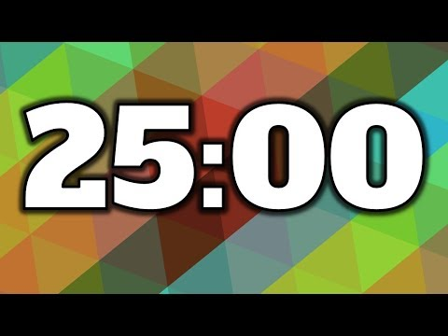
Today’s Lab Assignment
Work in groups of 3 to complete today’s Canvas assignment:
Practicum 2 - Functions
Spending roughly 25 minutes on this.
I’ll be walking around, Speaker should raise their hand to ask questions.
We will have discussion afterwards!

Slide 13
Reviewing Answers
Let’s make a reference solution for the lab section!
Each group’s speaker will answer one question at a time.

Slide 14
Questions?

Slide 15
Open lab time
With the time remaining in lab, please work on open assignments and ask me questions.

Slide 16
CISC108
Have a great day!
Don’t forget:
Need to finish module 2 this week!
Need to read Primer 3 before next lab!
See ya!

